Slide 1




NEXT GEN EMPLOYABILITY PROGRAM
Creating a future-ready workforce
Team Members
College Name
Student Name : Sam Selin D
Student ID :au951221104039
JP College Of Engineering

Slide 2

CAPSTONE PROJECT SHOWCASE
Project Title
Voting Web Application using Django Framework
Abstract | Problem Statement | Project Overview | Proposed Solution | Technology Used | Modelling & Results | Conclusion

Slide 3
Abstract
In this presentation, we embark on a journey to create a dynamic and interactive voting web application using Django, a powerful Python web framework. Django empowers developers to rapidly build web applications with its robust features and elegant design. Our step-by-step guide begins with an exploration of Django's capabilities and its significance in modern web development. We delve into the intricacies of project setup, database configuration, and model definition, shedding light on the architecture behind our voting application. With a focus on practicality, we navigate through the creation of views and templates, illustrating how Django seamlessly integrates frontend and backend components. URL routing becomes our compass as we map out the navigation structure of our application.
Source :

Slide 4
Problem Statement
Conventional polling methods lack user engagement and real-time interaction, impeding effective data collection and decision-making processes.
The manual handling of voting data is time-consuming, error-prone, and lacks scalability, particularly in scenarios with large participant numbers or frequent polling events.
Existing polling systems often lack robust security measures, leaving them vulnerable to unauthorized access, data breaches, and tampering, compromising the integrity and confidentiality of voting outcomes.
Building a custom voting web application from scratch requires significant expertise in web development, backend programming, and database management, posing challenges for individuals or organizations with limited technical resources.
Source :

Slide 5
Project Overview
Develop a real-time voting web application using Django to enhance user engagement and streamline data collection processes efficiently.
Implement user-friendly interfaces for polls, integrate secure authentication mechanisms for data integrity, offer real-time result updates, and ensure accessibility compliance for all users.
Utilize Django's MVT architecture, employing models for data representation, views for request handling, and templates for dynamic content rendering, ensuring scalability and maintainability.
Encompass setup of Django environment, creation of data models for voting components, integration of authentication features, UI design for intuitive user experience, security implementation, and rigorous testing for functionality validation.
Source :

Slide 6
Proposed Solution
The proposed solution involves developing an interactive voting platform using Django, a user-friendly web framework. Through this platform, users can seamlessly participate in polls in real-time, fostering engagement and simplifying data collection processes. To ensure the integrity of the voting process, robust authentication mechanisms will be implemented, allowing only authorized users to access and contribute to polls.
1. Interactive Voting Platform
2. Secure Authentication
3. Secure Authentication
4. Real-Time Updates
5. Scalable Architecture
6. Accessibility Features
7. Data Encryption
8. Comprehensive Testing
.

Slide 7
Advantages:
The interactive nature of the voting platform encourages active participation, leading to increased engagement among users and fostering a sense of community involvement.
The platform simplifies the process of collecting voting data in real-time, allowing organizers to gather insights quickly and make informed decisions promptly.
Robust authentication measures and encryption techniques ensure the integrity and confidentiality of voting data, safeguarding against unauthorized access and data breaches.
With its intuitive interface and accessibility features, the platform caters to users of all abilities, providing an inclusive voting experience that is easy to navigate and understand.
Source :

Slide 8
Disadvantages:
Developing and maintaining the voting platform requires technical expertise, potentially limiting its accessibility to organizations or individuals lacking programming skills.
Despite security measures, the platform may still be vulnerable to sophisticated cyber attacks or hacking attempts, posing risks to the integrity and confidentiality of voting data
Running a real-time voting platform requires adequate server resources and bandwidth, which could incur significant costs for hosting and maintenance, especially for large-scale usage.
Some users may be hesitant to engage with online voting platforms due to concerns about privacy, trust, or unfamiliarity with the technology, leading to lower participation rates compared to traditional voting methods.
Source :

Slide 9
Technology Used
Front-end
1.HTML
2.CSS
3.JavaScript
4.Bootstrap
Back-end
1.Python
2.Django
3.SQL
Source :

Slide 10
Modelling & Results
Model Definition: Define "Question" and "Choice" models in Django, storing question text, publication dates, and choices with their corresponding vote counts, facilitating organized data storage and retrieval.
Implementation of Views and Templates: Create interactive views and templates for users to browse questions, select choices, and submit votes, ensuring a seamless and intuitive voting experience while dynamically updating voting results.
Security Measures: Implement user authentication to control access and encryption techniques to protect voting data, ensuring confidentiality and integrity, and mitigating risks of unauthorized access or tampering.
Testing and Deployment: Conduct rigorous testing to validate functionality, usability, and security, then deploy the platform, continuously monitoring its performance and gathering user feedback for iterative improvements, ensuring a reliable and user-friendly voting platform.
Source :

Slide 11
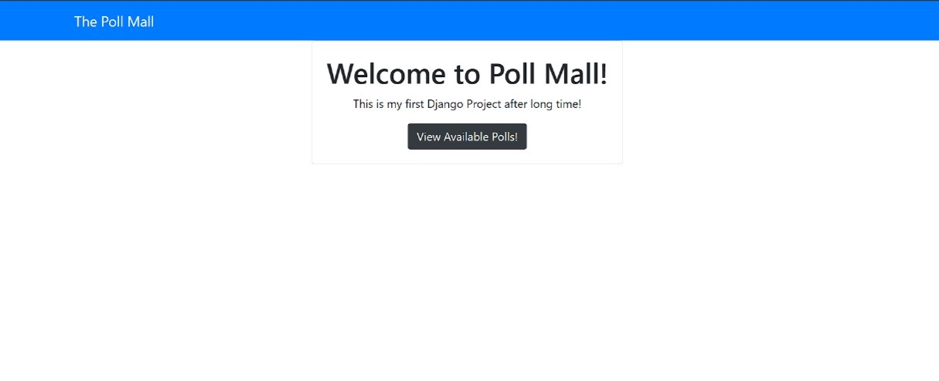
Homepage

Slide 12
About-Us-Page
Welcome to our voting platform! We're a team passionate about making democratic participation easy and secure for everyone. Using Django, a trusted web framework, we've built a user-friendly platform for conducting polls and gathering valuable insights.
Our priority is your security. We've implemented strict authentication and encryption to protect your data and ensure the integrity of every vote.
Accessibility is key to us. Our platform is designed to be inclusive and easy to use for everyone, regardless of ability.
Join us as we work towards a future where everyone's voice counts.

Slide 13
Service-Page
Poll Creation
Real-Time Results
Secure Authentication
Data Privacy
Accessibility Features
Scalable Infrastructure
Customization Options
Expert Support

Slide 14
Departments-Page
Administration
Development
Security
Customer Support
Design and Accessibility
Marketing and Outreach
Research and Development
Legal and Compliance

Slide 15
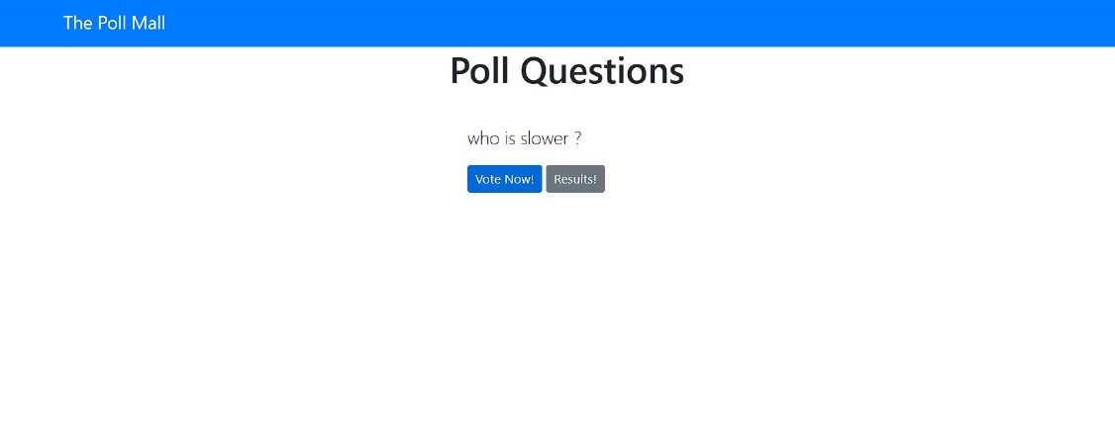
Poll Questions

Slide 16
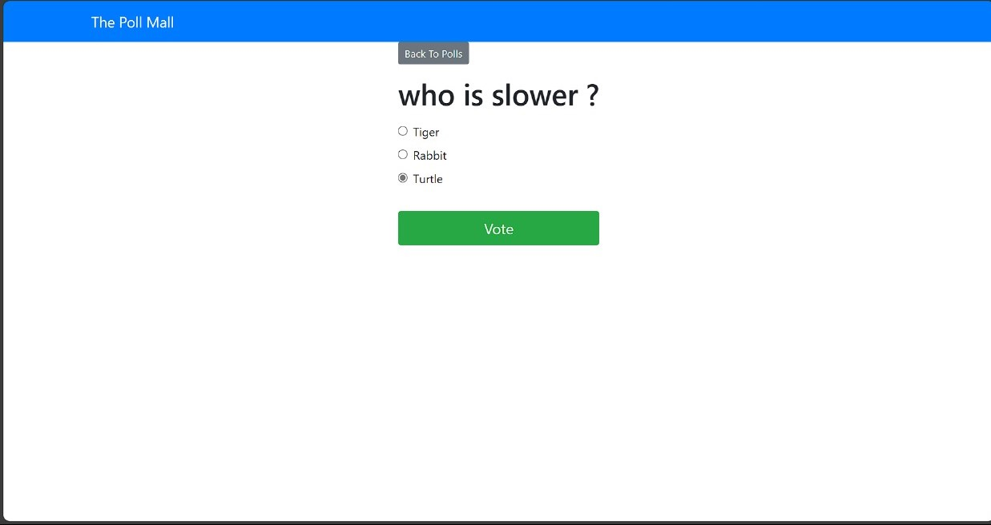
Voting Status

Slide 17
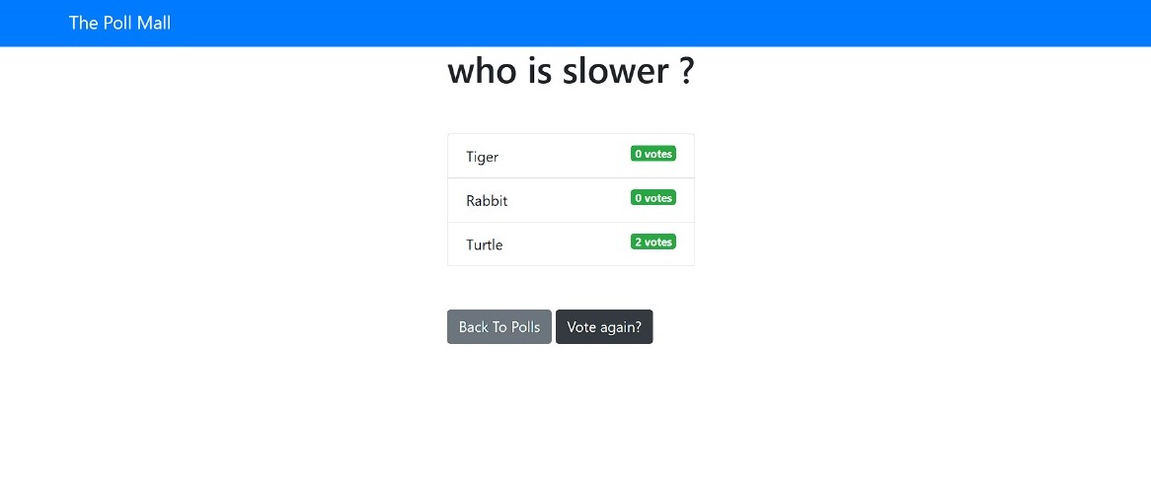
Voted List

Slide 18
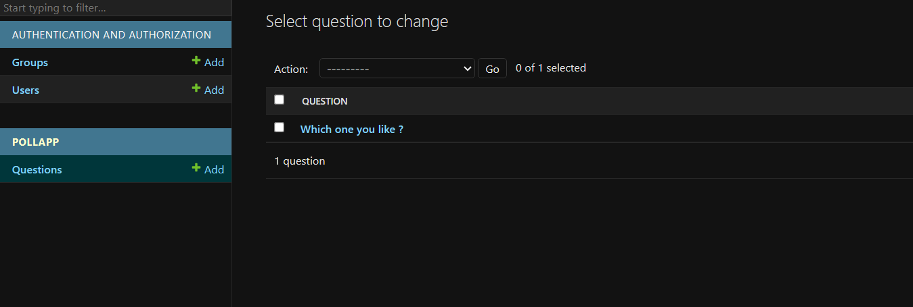
Admin Page

Slide 19
Future Enhancements:
Implement advanced analytics features to provide in-depth insights into voting trends, demographics, and user behaviors, enabling organizations to make data-driven decisions and optimize their strategies.
Enable seamless integration with popular social media platforms to facilitate broader reach and engagement, allowing users to share polls, invite friends to participate, and generate viral interest in voting events.
Continuously enhance security measures by adopting emerging technologies such as blockchain for transparent and immutable voting records, ensuring the highest level of integrity and security for voting processes.
Develop dedicated mobile applications for iOS and Android devices, offering users the convenience of voting on-the-go and accessing voting events from their smartphones or tablets.
Expand language support to cater to a global audience, allowing users to access the platform and participate in polls in their preferred language, thereby promoting inclusivity and accessibility.

Slide 20
Conclusion
In conclusion, our voting platform offers a user-friendly and secure solution for conducting polls and gathering valuable insights. With features such as real-time results, secure authentication, and accessibility compliance, we strive to empower organizations and individuals to engage in democratic decision-making processes effectively. As we continue to evolve and implement future enhancements, our commitment remains unwavering: to provide a reliable, inclusive, and innovative platform for facilitating meaningful interactions and driving positive change.
Source :

Slide 21
Thank You!
Notes:
Thank You !!

